Slide 1
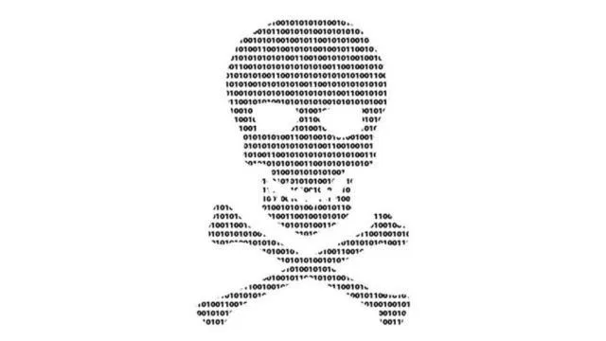
MGMT 571: DATA MINING
KAGGLE COMPETITION
BANKRUPTCY PREDICTION
Data Pirates
Abhishek Bhambhu
Deeksha Goyal
Shruti Gupta
MS BAIM 2019-20 | KRANNERT SCHOOL OF MANAGEMENT

Slide 2
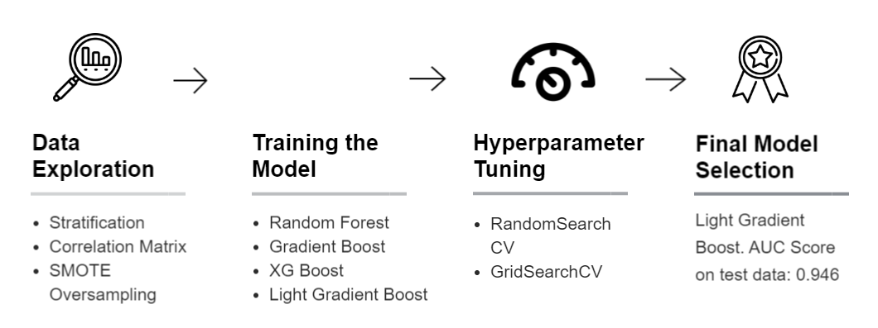

Four Phase Process
MS BAIM 2019-20 | KRANNERT SCHOOL OF MANAGEMENT

Slide 3
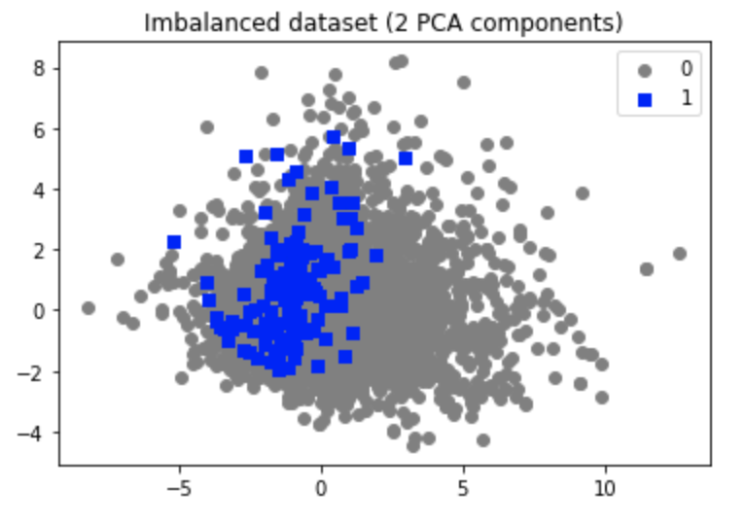
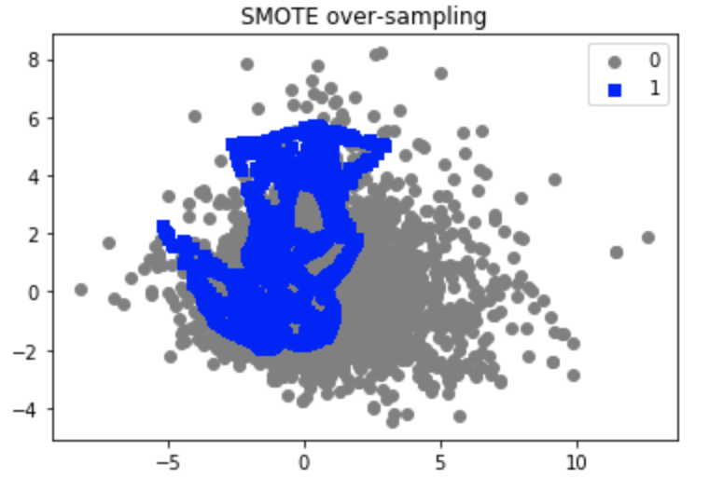
SMOTE Oversampling (before and after)
MS BAIM 2019-20 | KRANNERT SCHOOL OF MANAGEMENT

Slide 4
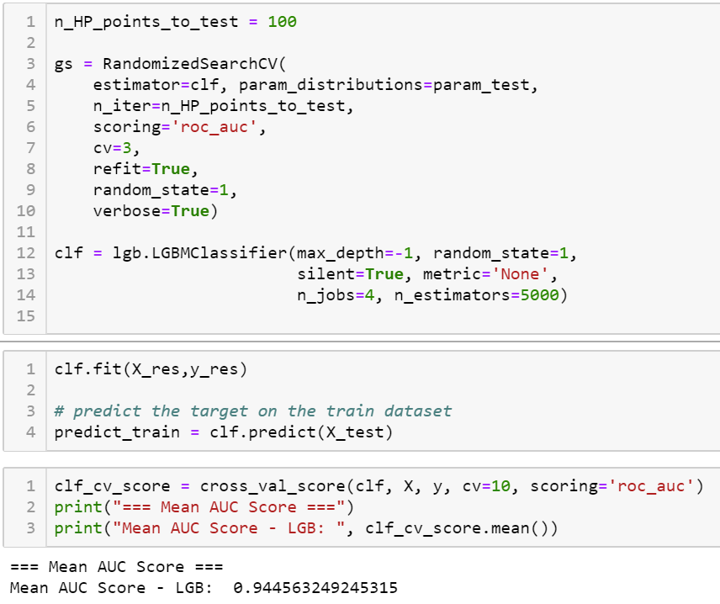
Hyperparameter Tuning
Best Fit: num_leaves, max_depth, min_data_leaf
Speed: bagging_fraction, feature_fraction, max_bin
Accuracy: num_leaves, max_bin
Parameters Used for Training:
Max_depth
Num_leaves
Min_child_samples
N_estimator
N_jobs
MS BAIM 2019-20 | KRANNERT SCHOOL OF MANAGEMENT

Slide 5
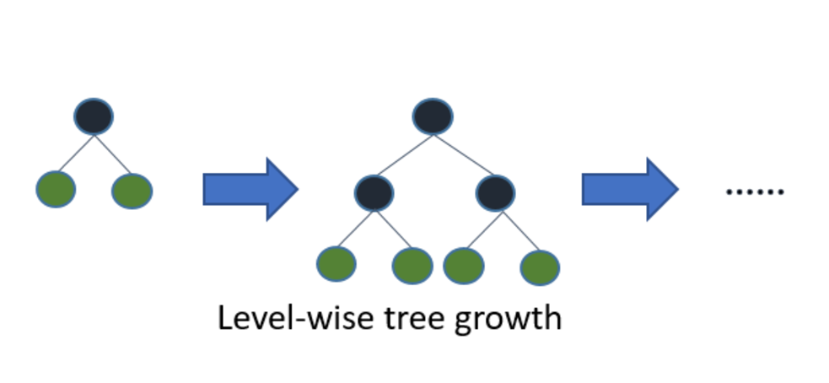
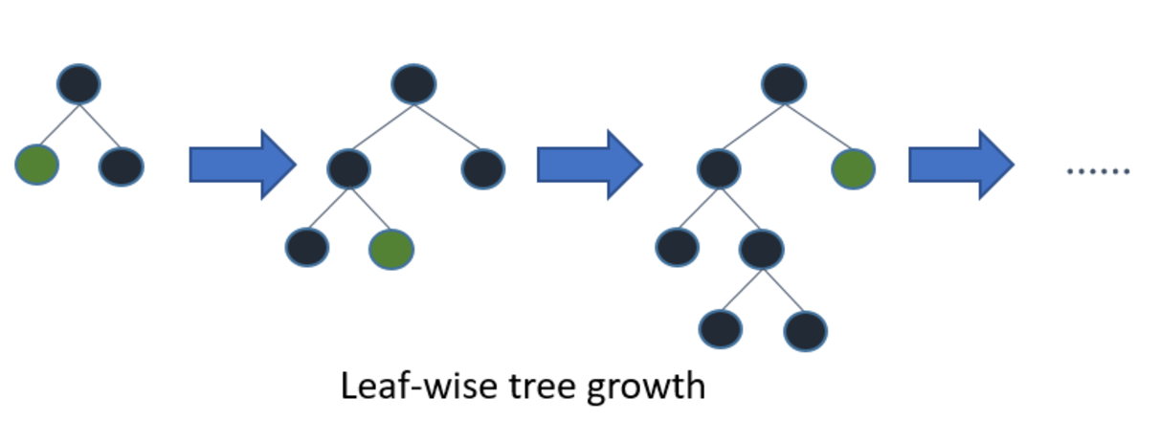
WHY Light Gradient Boost Method
Light GBM is prefixed as ‘Light’ because of its high speed. Light GBM can handle the large size of data and takes lower memory to run.
vs
LGBM
Others
MS BAIM 2019-20 | KRANNERT SCHOOL OF MANAGEMENT

Slide 6
THANK YOU
MS BAIM 2019-20 | KRANNERT SCHOOL OF MANAGEMENT

